Slide 1
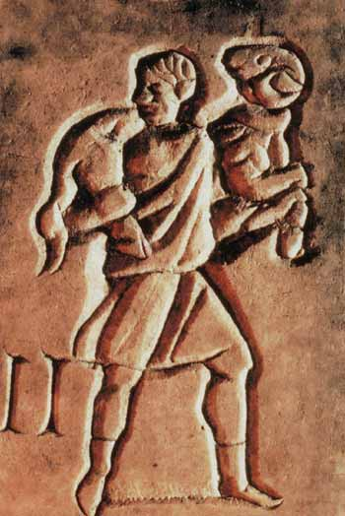
The Good Shepherd in Early Christian Art
Gathered for a slide presentation for a Bible study written by Dr. Rick Jordan

Slide 2
The Good Shepherd with his flock - Dura-Europos house in Syria, 233-255 AD
The earliest house converted to a church that we know of. One of the earliest depictions of Jesus in art.

Slide 3
Sarcofago 49 del buon pastore (180-200 ca.)
The Good Shepherd is the most common theme in earliest Christian art, usually found in frescos and sarcophagi (stone coffins) such as this one.

Slide 4
Baths of Diocletian, Rome, 4th century AD
An etching on marble.

Slide 5
The Good Shepherd in a garden, 350-375 AD
The Domitilla catacomb in Rome contains over nine miles of subterranean passages. This wall painting of the Good Shepherd is painted on an apse in the cubiculum (i.e., a large room). This image dates from 350-75 CE.

Slide 6
Ceiling of Cubiculum in the Catacomb of Ss. Pietro and Marcellinus
The image of the Good Shepherd is found approximately 120 times in the Roman catacombs, and it is especially common in the older ones.

Slide 7
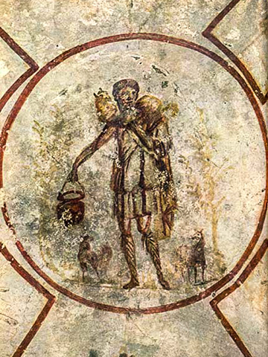
Good Shepherd from the Catacomb of Calixtus
A mid-3rd century fresco of "The Good Shepherd" in the Catacomb of St. Calixtus in Rome. These catacombs are among the oldest and certainly the largest (12 miles of tunnels over 90 acres and four levels that house the remains of half a million Christians), and were the final resting place of 16 early popes.

Slide 8
Christian cubiculum tomb in the Catacomb of Priscilla in Rome, Italy
Center of the ceiling of the “Velatio” cubicle: the Good Shepherd (also sheep and doves with olive branches in trees).

Slide 9
Introductory slide image is from a tombstone which has an inscription dedicated by parents of a deceased 7 year old girl, Apuleia Crysopolis; Good Shepherd and Tree of Life (Catacomb of St. Callisto, Rome)
Credits:
All photographs are in the public domain with these exceptions:
Slide 2: "Sarcofago 49 del buon pastore (180-200 ca.), 01" by I, Sailko. Licensed under CC BY-SA 3.0 via Wikimedia
Slide 3: Christian image of Christ as the Good Shepherd (Fourth Century A.D.), Museo Epigrafico, Rome (Foto: Kleuske)

