Slide 1
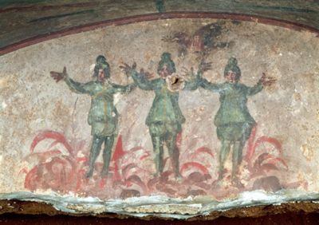
Catacomb of Priscilla, Rome, late 3rd century/early 4th century AD.

Slide 2
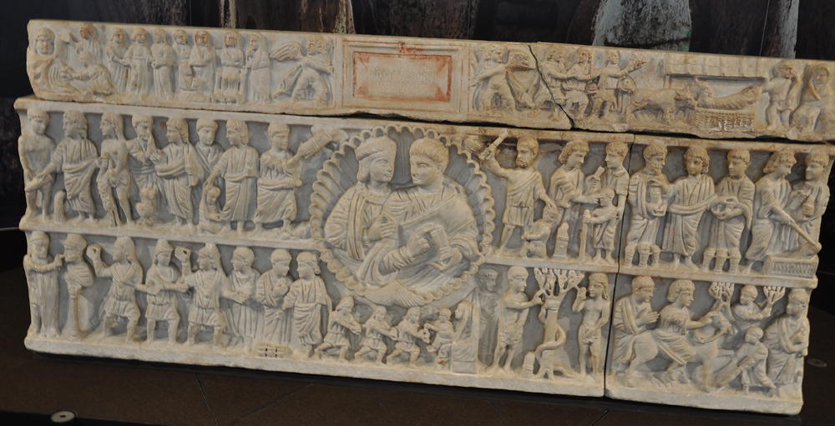

Slide 3
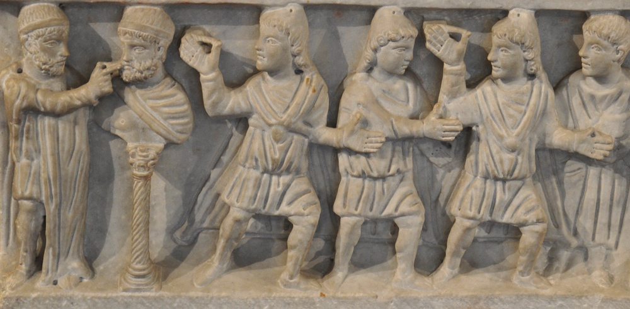
The Sarcophagus of Adelphia: Detail, Shadrach, Mishach, and Abednego
From the Catacombs of St. John, Syracuse, Sicily
2nd quarter of the 4th century AD

Slide 4
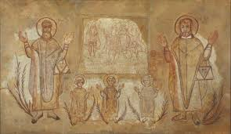
Wall-painting with the three Hebrews in the fiery furnace and the martyrs Cosmas and Damian 500-700 AD

Slide 5
Casket art
A Byzantine bronze plaque that once was part of a casket, with eight perforations around the edges for attachment. A scene was created on it by hammering.
Dating: Byzantine, circa 4th-6th century C.E.
Provenance: UK private collection, acquired in the 1980s; thereafter with Charles Ede Ltd., London.
© Alexander Ancient Art

Slide 6
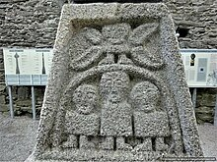
Depicted on Moone High Cross, Ireland, 10th century

Slide 7
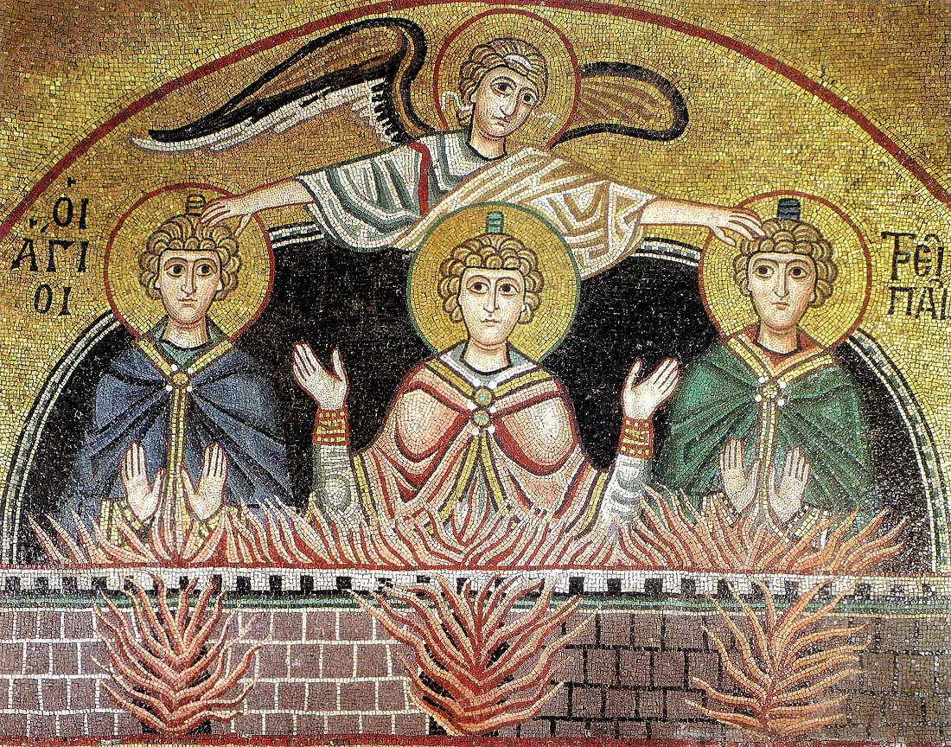
Tile mosaic – 11th Century AD

Slide 8
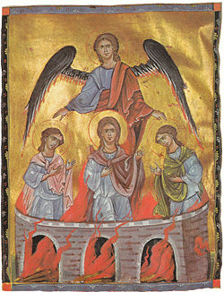
Fiery furnace (1266) by Toros Roslin.

Slide 9
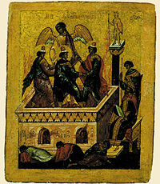
The Three Young Men in the Fiery Furnace (15th century icon of the Novgorod school).

Slide 10
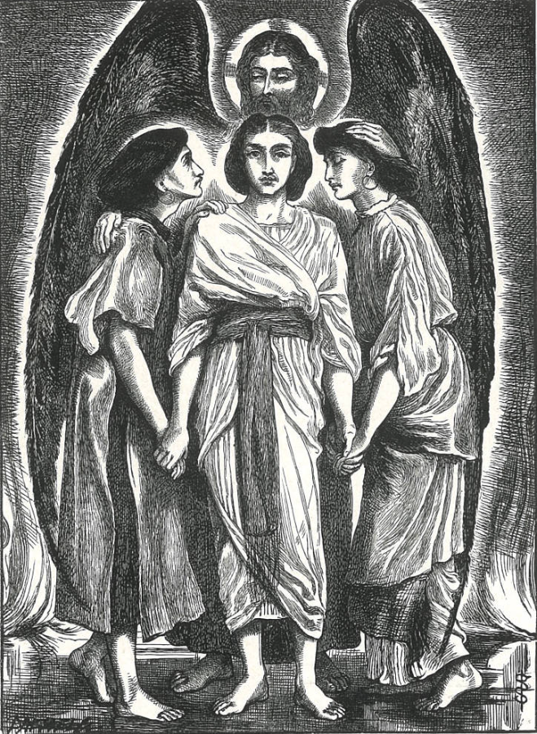
Shadrach, Meshach, and Abednego
Simeon Solomon
Wood engraving by the Dalziels [1862].
6½ x 4¾ inches
Foley, Alex. Art Pictures from the Old Testament and Our Lord’s Parables. London: Edwin Dalton [1921].
https://victorianweb.org/art/illustration/ssolomon/22.html

Slide 11
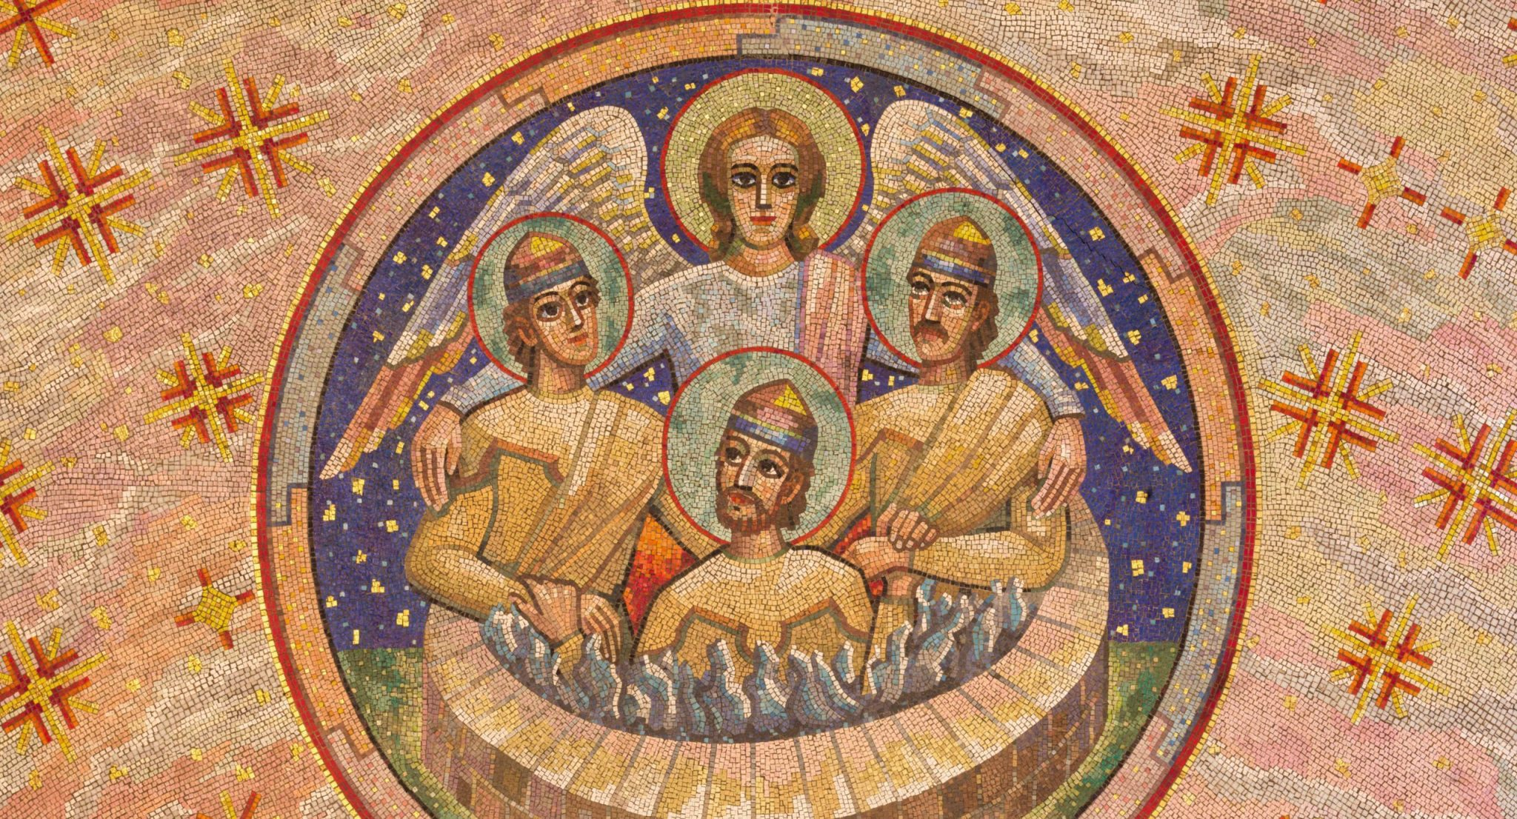
London - Mosaic of Shadrach, Meshach, and Abednego in a fiery furnace in Westminster cathedral and Blessed Sacrament Chapel designed by Boris Anrep (middle 20. cent.).

Slide 12
